Slide 1
Introduction to the Message Passing Interface - MPI
Kevin Brown
Argonne National Laboratory
Donald Frederick
Lawrence Livermore National Laboratory
Tapia Conference 2022
LLNL-CONF-837957-DRAFT

Slide 2
Agenda
What is MPI?
Why does one use MPI?
MPI References

Slide 3
What is MPI ?
An Interface Specification -M P I = Message Passing Interface
MPI is a specification for the developers and users of message passing libraries. It is the specification of what such a library should be.
MPI addresses the message-passing parallel programming model: data is moved from the address space of one process to that of another process through cooperative, concurrent operations on each process.
The goal of the Message Passing Interface is to provide a widely used standard for writing message passing programs. The interface attempts to be:
Practical
Portable
Efficient
Flexible
The MPI standard has gone through a number of revisions, with the most recent version being MPI-3.x
Interface specifications have been defined for C and Fortran90 language bindings:
C++ bindings from MPI-1 are removed in MPI-3
MPI-3 also provides support for Fortran 2003 and 2008 features
Actual MPI library implementations differ in which version and features of the MPI standard they support.

Slide 4
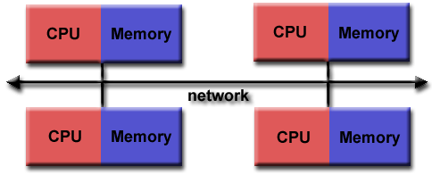
Parallel Programming Model
Programming Model - Originally, MPI was designed for distributed memory architectures, which were becoming increasingly popular at that time (1980s - early 1990s).

Slide 5
Parallel Programming Model
As architecture trends changed, shared memory SMPs were combined over networks creating hybrid distributed memory / shared memory systems.
MPI implementors adapted their libraries to handle both types of underlying memory architectures seamlessly. They also adapted/developed ways of handling different interconnects and protocols.
Today, MPI runs on virtually any parallel hardware platform:
Distributed Memory
Shared Memory
Hybrid

Slide 6
MPI Basics
Multiple, concurrent tasks launched – each with own control flow, memory
Tasks communicate via messages – sent/received via a hardware communication channel.
Messages contain data, can be used to coordinate concurrent tasks

Slide 7
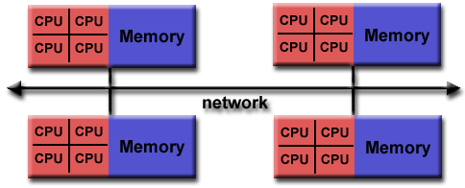
Parallel Programming Model
This is the common platform for MPI-based parallel programming today.

Slide 8
Parallel Programming Model
Reasons for Using MPI
MPI allows concurrent use of multiple nodes/cpus/core in a linux cluster.
Standardization - MPI is the only message passing library that can be considered a standard. It is supported on virtually all HPC platforms. Practically, it has replaced all previous message passing libraries.
Portability - There is little or no need to modify your source code when you port your application to a different platform that supports (and is compliant with) the MPI standard.
Performance Opportunities - Vendor implementations should be able to exploit native hardware features to optimize performance. Any implementation is free to develop optimized algorithms.
Functionality - There are over 430 routines defined in MPI-3, which includes the majority of those in MPI-2 and MPI-1.
NOTE: Most MPI programs can be written using a dozen or less routines
Availability - A variety of implementations are available, both vendor and public domain.

Slide 9
MPI Components
MPI Library – there are many library implementations
MPI run-time infrastructure – implementation-dependent
MPI task launcher – varies with library implementation
Often, ”mpirun” used as MPI task launcher
Example -
mpirun –n 64 ./a.out
Launches 64 MPI tasks
MPI Environment variables – implementation-dependent
Example -

Slide 10
MPI Is “Small” and “Big”
Small
One can implement wide range of message-passing algorithms using just 6 basic MPI routines – send/receive messages.
Big
Latest version (June 2021) of MPI Standard has over 300 routines
Notes:
Routines have been added/removed due to user requests, development of HPC message-passing infrastructure, etc.

Slide 11
MPI – Program Structure
Most MPI program can be written with 6 basic MPI functions
MPI Initialization
Define region of program executing on multiple MPI tasks
Basic MPI Send/Receive messages
Sending/Receiving information - for computation, program control
MPI “interrogation” functions
Information for program control
MPI “finalization” – end MPI context

Slide 12
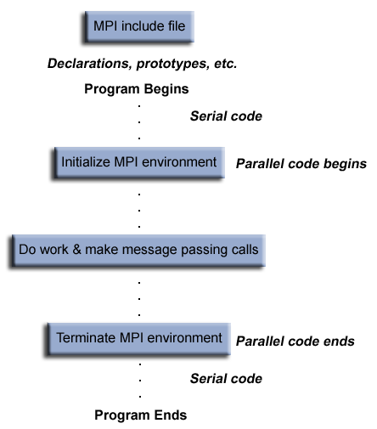
Program Structure - MPI
Notes:
Generic program structure of an MPI program

Slide 13
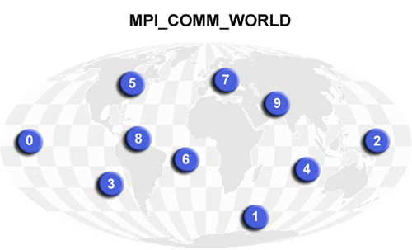
MPI Program Structure -
Notes:
Communicators and Groups:
MPI uses objects called communicators and groups to define which collection of processes may communicate with each other.
Most MPI routines require you to specify a communicator as an argument.

Slide 14
MPI – Program Structure – Components: Include File
Header File:
Required for all programs that make MPI library calls.
C include file | Fortran include file
#include "mpi.h" | include 'mpif.h'
Notes:
Every MPI program must have an include file specified – defines MPI-related objects

Slide 15
MPI – Program Structure
Format of MPI Calls:
C names are case sensitive; Fortran names are not.
C Binding
Format: | rc = MPI_Xxxxx(parameter, ... )
Example: | rc = MPI_Bsend(&buf,count,type,dest,tag,comm)
Error code: | Returned as "rc". MPI_SUCCESS if successful
Fortran Binding
Format: | CALL MPI_XXXXX(parameter,..., ierr) call mpi_xxxxx(parameter,..., ierr)
Example: | CALL MPI_BSEND(buf,count,type,dest,tag,comm,ierr)
Error code: | Returned as "ierr" parameter. MPI_SUCCESS if successful

Slide 16
MPI Environment Management/Interrogation Functions
MPI_Init
Initializes the MPI execution environment. This function must be called in every MPI program, must be called before any other MPI functions and must be called only once in an MPI program. For C programs, MPI_Init may be used to pass the command line arguments to all processes, although this is not required by the standard and is implementation dependent.
MPI_Init (&argc,&argv)
MPI_INIT (ierr)

Slide 17
MPI Environment Management/Interrogation Functions
MPI_Comm_size
Returns the total number of MPI processes in the specified communicator, such as MPI_COMM_WORLD. If the communicator is MPI_COMM_WORLD, then it represents the number of MPI tasks available to application.
MPI_Comm_size (comm,&size)
MPI_COMM_SIZE (comm,size,ierr)

Slide 18
MPI Environment Management/Interrogation Functions
MPI_Comm_rank
Returns the rank of the calling MPI process within the specified communicator. Each MPI process is assigned a unique integer rank between 0 and number of tasks - 1 within the communicator MPI_COMM_WORLD. This rank is often referred to as a task ID.
MPI_Comm_rank (comm,&rank)
MPI_COMM_RANK (comm,rank,ierr)

Slide 19
MPI Environment Management/Interrogation Functions
MPI_Finalize
Terminates the MPI execution environment. This function should be the last MPI routine called in every MPI program - no other MPI routines may be called after it.
MPI_Finalize ()
MPI_FINALIZE (ierr)

Slide 20
A Simple MPI Program – Hello World
MPI_Init(&argc, &argv);
MPI_Comm_size(MPI_COMM_WORLD, &numtasks);
MPI_Comm_rank(MPI_COMM_WORLD,&taskid);
MPI_Get_processor_name(hostname, &len);
printf ("Hello from task %d on %s!\n", taskid, hostname);
if (taskid == MASTER)
printf("MASTER: Number of MPI tasks is: %d\n",numtasks);
MPI_Finalize();
}
#include "mpi.h"
#include <stdio.h>
#include <stdlib.h>
#define MASTER 0
int main (int argc, char *argv[])
{
int numtasks, taskid, len;
char hostname[MPI_MAX_PROCESSOR_NAME];
Notes:
With This example, sveral of basic MPI functions are used – initialization, interrogation to determine how many MPI tasks are launched, determining task id, finalization of MPI context.

Slide 21
A Simple MPI Program – Hello World Output – Run on One Node
mpirun –n6 hello.x
Task launcher mpirun launches 6 mpi tasks
MASTER: Number of MPI tasks is: 6
Hello from task 1 on ruby238!
Hello from task 4 on ruby238!
Hello from task 5 on ruby238!
Hello from task 3 on ruby238!
Hello from task 2 on ruby238!
Hello from task 0 on ruby238!
In this case, all 6 MPI tasks ran on one node. However, MPI allows running across multiple nodes.
Notes:
In this case, all 6 MPI tasks ran on one node. However, keep in mind that MPI allows one to run across multiple nodes.

Slide 22
A Simple MPI Program – Hello World Output – Run Across 2 Nodes
Hello from task 70 on ruby139!
Hello from task 40 on ruby139!
Hello from task 42 on ruby139!
Hello from task 50 on ruby139!
Hello from task 51 on ruby139!
Hello from task 61 on ruby139!
Hello from task 63 on ruby139!
Hello from task 71 on ruby139!
Hello from task 8 on ruby138!
Hello from task 46 on ruby139!
Hello from task 41 on ruby139!
Hello from task 30 on ruby138!
Hello from task 22 on ruby138!
Hello from task 31 on ruby138!
Hello from task 37 on ruby139!
Hello from task 52 on ruby139!
Hello from task 27 on ruby138!
Hello from task 23 on ruby138!
Hello from task 47 on ruby139!
Hello from task 16 on ruby138!
Hello from task 4 on ruby138!
Hello from task 53 on ruby139!
Hello from task 5 on ruby138!
Hello from task 11 on ruby138!
Hello from task 39 on ruby139!
Hello from task 45 on ruby139!
Hello from task 44 on ruby139!
…
…
Hello from task 43 on ruby139!
MASTER: Number of MPI tasks is: 72
In this case, each ruby node has 36 cores and 1 MPI task ran on each core
Hello from task 33 on ruby138!
Hello from task 64 on ruby139!
Hello from task 68 on ruby139!
Hello from task 34 on ruby138!
Hello from task 32 on ruby138!
Hello from task 18 on ruby138!
Hello from task 21 on ruby138!
Hello from task 19 on ruby138!
Hello from task 20 on ruby138!
Hello from task 28 on ruby138!
Hello from task 35 on ruby138!
Hello from task 24 on ruby138!
Hello from task 36 on ruby139!
Hello from task 65 on ruby139!
Hello from task 69 on ruby139!
Hello from task 66 on ruby139!
Hello from task 67 on ruby139!
Hello from task 10 on ruby138!
Hello from task 25 on ruby138!
Hello from task 29 on ruby138!
Hello from task 26 on ruby138!
Hello from task 49 on ruby139!
Hello from task 9 on ruby138!
Hello from task 48 on ruby139!
Hello from task 17 on ruby138!
Hello from task 58 on ruby139!
Hello from task 60 on ruby139!

Slide 23
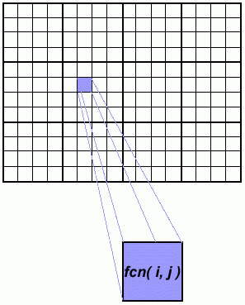
A Simple MPI Program 2-D Array Assignment Example
This example demonstrates calculations on 2-dimensional array elements;
a function is evaluated on each array element.
The computation on each array element is independent from other array elements.
The problem is computationally intensive
The serial program calculates one element at a time in sequential order.
Serial code for this may look like:
do j = 1,n
do i = 1,n a(i,j) = fcn(i,j)
end do
end do

Slide 24
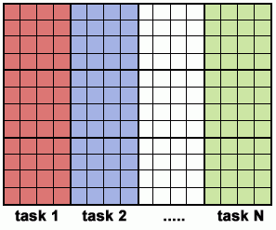
A Simple MPI Program 2-D Array Assignment Example – Paralleism
The calculation of elements is independent of one another - leads to an embarrassingly parallel solution.
Arrays elements are evenly distributed so that each process owns a portion of the array (subarray).
Distribution scheme is chosen for efficient memory access; e.g. unit stride (stride of 1) through the subarrays.
Unit stride maximizes cache/memory usage.
Independent calculation of array elements ensures there is no need for communication or synchronization between tasks.
After the array is distributed, each task executes the portion of the loop corresponding to the data it owns.

Slide 25
A Simple MPI Program 2-D Array Assignment Example - Parallelism
Pseudocode example showing changes for parallel implementation
in red
for i (i = mystart; i < myend; i++)
{ for j (j = 0; j < n; j++)
{ a(i,j) = fcn(i,j);
}
}

Slide 26
A Simple MPI Program 2-D Array Assignment Example – Pseudocode for Parallel case
find out if I am MASTER or WORKER
if I am MASTER
initialize the array
send each WORKER info on part of array it owns
send each WORKER its portion of initial array
else if I am WORKER
receive from MASTER info on part of array I own receive from MASTER my portion of initial array calculate my portion of array
do j = my first column,my last column
do i = 1,n a(i,j) = fcn(i,j)
end do
end do
send MASTER results
endif

Slide 27
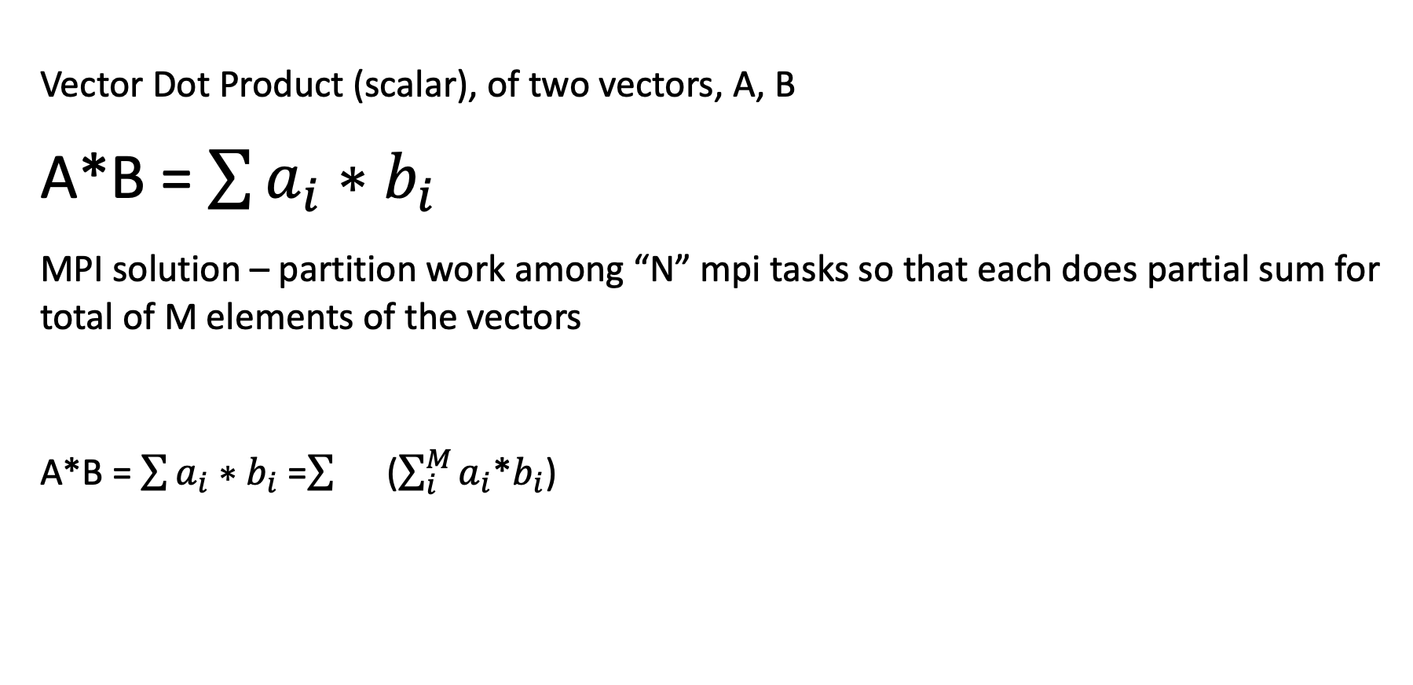
A Simple MPI Program – Vector Dot Product
Vector Dot Product (scalar), of two vectors, A, B
A*B = $\sum{a_{i}{∗b}_{i}}$
MPI solution – partition work among “N” mpi tasks so that each does partial sum for total of M elements of the vectors
A*B = $\sum{a_{i}{∗b}_{i}}$ = ($\sum_{i}^{M}{a_{i}}$*$b_{i}$)

Slide 28
A Simple MPI Program – Vector Dot Product Pseudocode
Am I BOSS or WORKER ?
if I am BOSS
initialize the array
send each WORKER info on part of array it owns
send each WORKER its portion of initial array (psum)
receive from each WORKER
results = psum
DotProd = Sum of psums
else if I am WORKER
receive from BOSS info on part of array I own
receive from BOSS my portion of initial array
# calculate my portion of array
do j = my first column,my last
psum = a(i)* b(i))
end do
send BOSS psum
endif

Slide 29
A Simple MPI Program – Vector Dot Product - Output
mpirun – n16 ./aout Launch 16 MPI tasks for DoProduct example
Output for example –
MPI task 0 has started...
Initialized array serial dot product = 3.200000e+07
Sent 4000000 elements to task 1 offset= 4000000
Sent 4000000 elements to task 2 offset= 8000000
Sent 4000000 elements to task 3 offset= 12000000
Task 0 mysum = 8.000000e+06
MPI task 1 has started...
Task 1 mysum = 8.000000e+06
MPI task 2 has started...
Task 2 mysum = 8.000000e+06
MPI task 3 has started...
Task 3 mysum = 8.000000e+06
…
…
*** Final parallel dot product = 3.200000e+07 ***
Notes:
a.out is an MPI executable

Slide 30
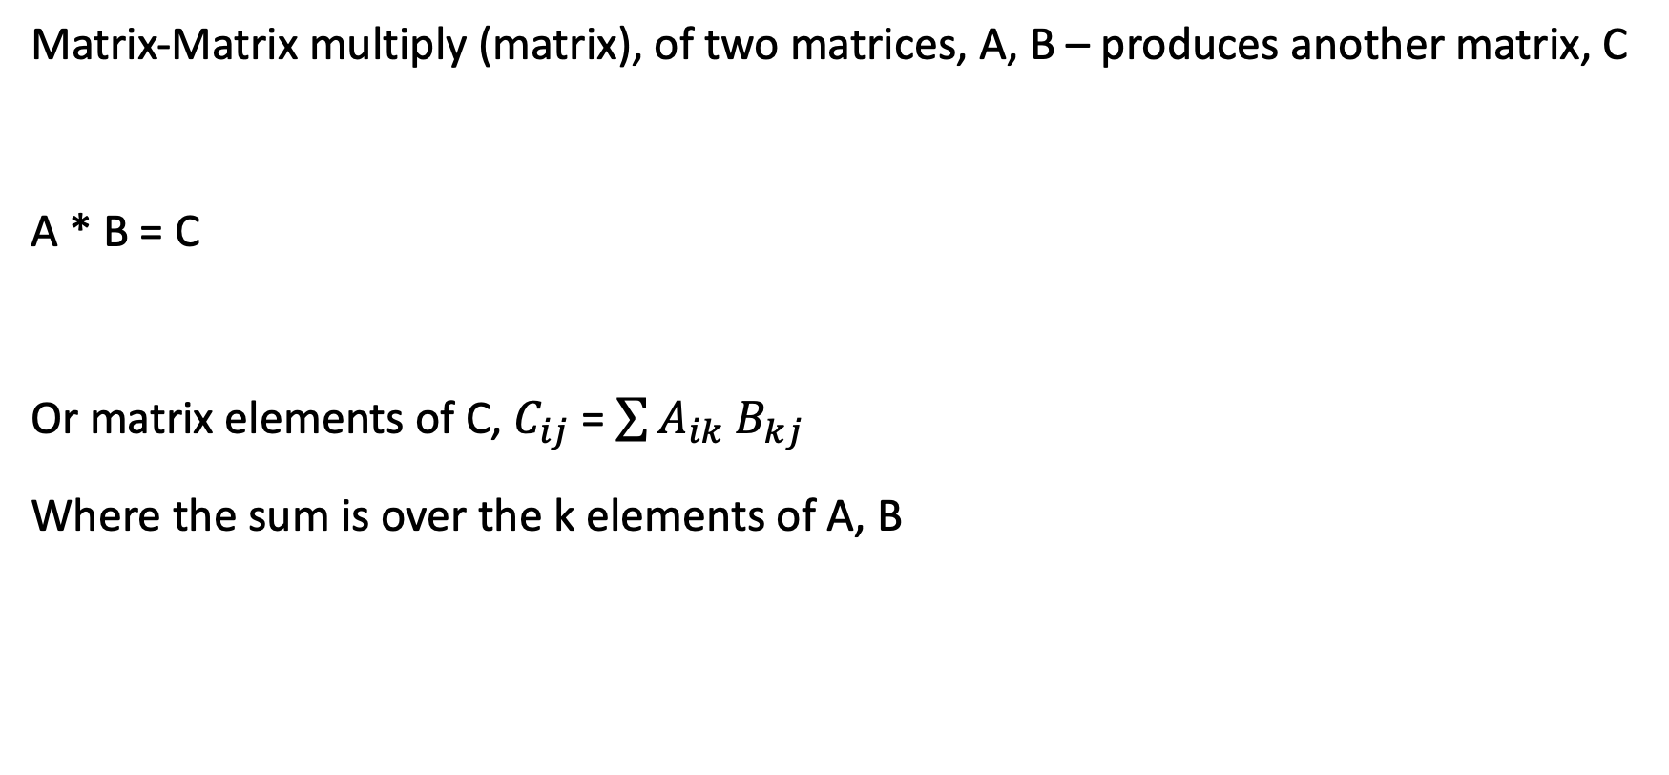
A Simple MPI Program – Matrix- Matrix Multiply
Matrix-Matrix multiply (matrix), of two matrices, A, B – produces another matrix, C
A * B = C
Or matrix elements of C, $C_{ij}$ = $\sum{A_{ik} B_{kj}}$
Where the sum is over the k elements of A, B

Slide 31
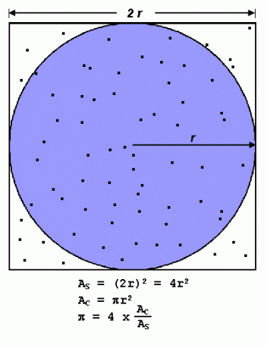
Calculating PI – Using Monte Carlo Method
Inscribe a circle with radius r in a square with side length of 2r
The area of the circle is Πr2 and the area of the square is 4r2
The ratio of the area of the circle to the area of the square is: Πr2 / 4r2 = Π / 4
If One randomly generates N points inside the square, approximately
N * Π / 4 of those points (M) should fall inside the circle.
Π is then approximated as:
N * Π / 4 = M Π / 4 = M / N Π = 4 * M / N
Note that increasing the number of points generated improves the approximation.

Slide 32
Calculating PI – Using Monte Carlo Method
Pseudocode for serial algorithm
npoints = 10000
circle_count = 0
do j = 1,npoints
generate 2 random numbers between 0 and 1
xcoordinate = random1
ycoordinate = random2
if (xcoordinate, ycoordinate) inside circle
then circle_count = circle_count + 1
end do
PI = 4.0*circle_count/npoints

Slide 33
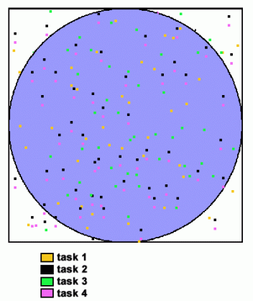
Calculating PI – Using Monte Carlo Method
A problem that's easy to parallelize:
All point calculations are independent; no data dependencies
Work can be evenly divided; no load balance concerns
No need for communication or synchronization between tasks
Parallel strategy:
Divide the loop into equal portions that can be executed by the pool of tasks
Each task independently performs its work
A SPMD model is used
One task acts as the master to collect results and compute the value of PI
Pseudo code solution: red highlights changes for parallelism.

Slide 34
Calculating PI – Using Monte Carlo Method - Pseudocode
npoints = 10000
circle_count = 0
p = number of tasks
num = npoints/p
find out if I am MASTER or WORKER
do j = 1,num
generate 2 random numbers between 0 and 1 xcoordinate = random1
ycoordinate = random2
if (xcoordinate, ycoordinate) inside circle
then circle_count = circle_count + 1
end do
if I am MASTER
receive from WORKERS their circle_counts
compute PI (use MASTER and WORKER calculations)
else if I am WORKER
send to MASTER circle_count
endif

Slide 35
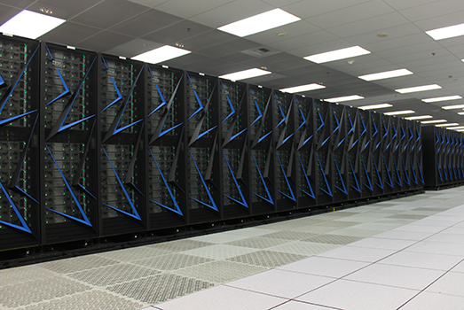
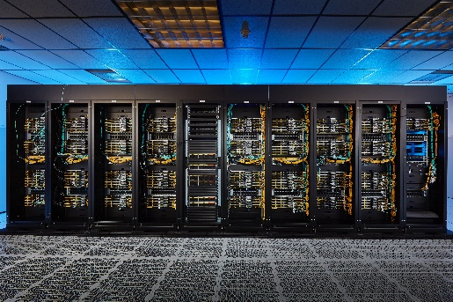

Systems for Running MPI - Examples
Lassen
Corona
Sierra
El Capitan
Quartz
Ruby
Today
On Your Laptop
Notes:
In addition to running on these large linux clusters, one can design, build and run MPI applications on a laptop.

Slide 36
4 MPI Exercises
Examples have been built and tested using gcc/10.2.1, mvapich2/2.3
MPI Hello World example
MPI Array assignment example
MPI Dot Product of Two Vectors
MPI Multiply Two Matrices
MPI Compute Pi using Monte Carlo Method
Building examples – after modifying makefile for your specific compiler MPI library
make mpi_hello
make mpi_array
make mpi_DotProd
make mpi_mm
make mpi_pi_send

Slide 37
5 MPI Exercises
If “a.out” is the MPI executable, run with
(for 4 MPI tasks)
mpirun –np 4 ./a.out

Slide 38
More MPI Information – References
LLNL Livermore Computing MPI Tutorial: https://hpc-tutorials.llnl.gov/mpi/
MPI Standard documents: http://www.mpi-forum.org/docs/
MPI Tutorials: www.mcs.anl.gov/research/projects/mpi/tutorial
MPI libraries that can be downloaded and installed on laptop
MPICH MPI Library - https://www.mpich.org/
MVAPICH MPI Library – https://mvapich.cse.ohio-state.edu/
OpenMPI MPI Library – https://www.open-mpi.org/
HPC References for MPI - Books
”Parallel and High Performance Computing”, Robey and Zamora
“An Introduction to Parallel Computing”, Pacheco and Malensek

